Slide 1
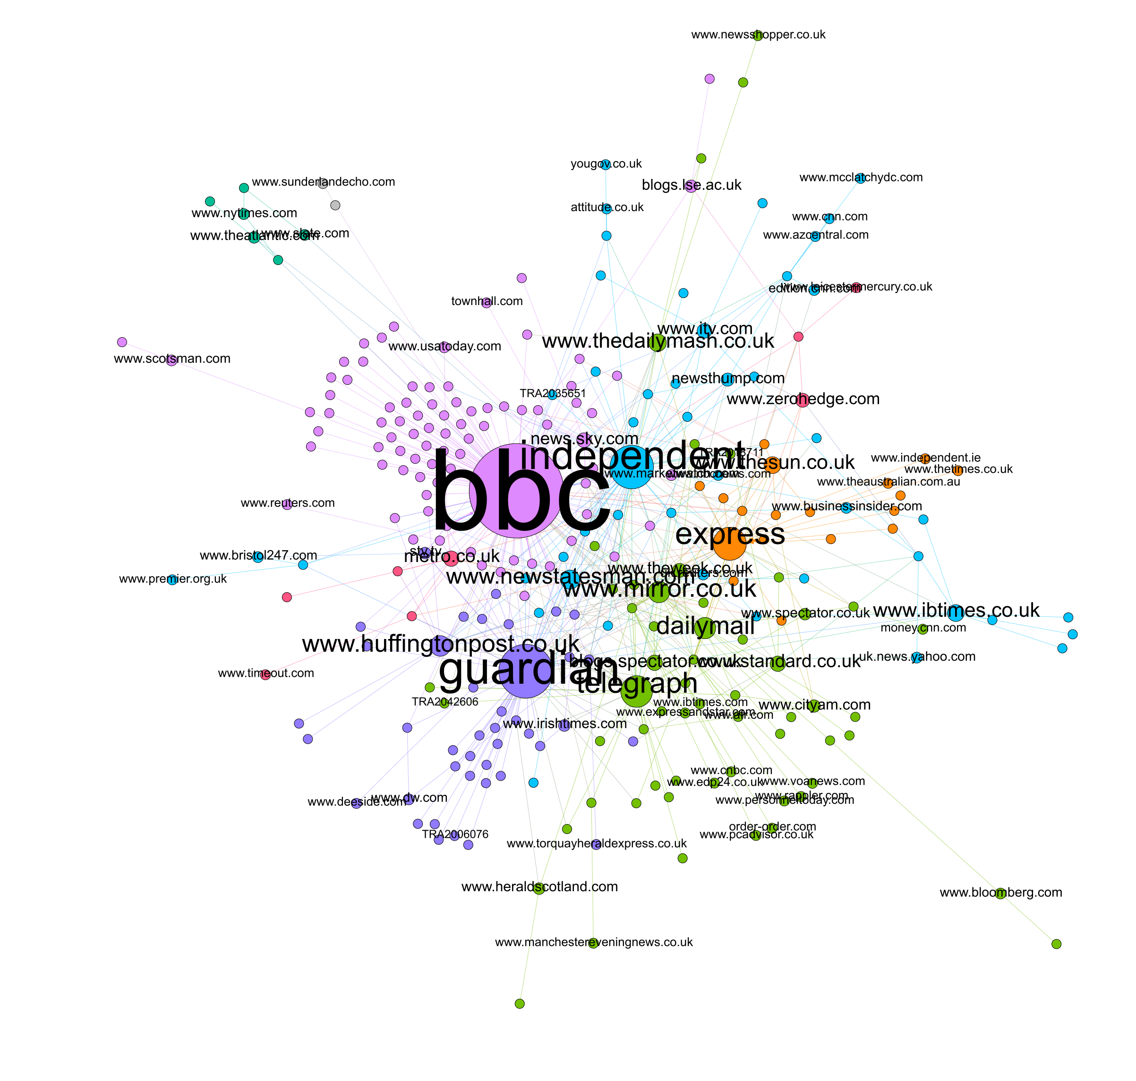

The Role of News Media in Shaping Voter Decisions:
A Study of the 2016 Brexit Referendum in the UK
Clemens Jarnach, Department of Sociology, University of Oxford
Supervisor: Prof Stephen Fisher, Professor of Political Sociology; Trinity College
Salzburg | 22 Sep 2023
Notes:
Thank you for inviting me and having me today here in Zürich

Slide 2
Objective
Examine political news consumption behaviour in Britain and its role in political opinion formation and voting behaviour
Focus: 2016 EU Referendum in UK
Jarnach, C., 2023, WAPOR

Slide 3
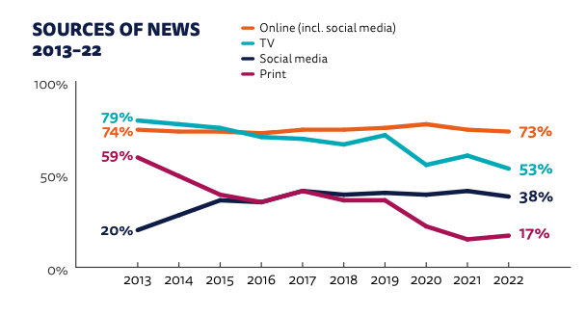
Sources of News in the UK
Source: Newman et al., 2022
Jarnach, C., 2023, WAPOR

Slide 4
Motivation
Media landscape is changing
Concerns about voters being increasingly ideologically segregated and isolated due to digital media
Debate whether voters, particularly Leave-Voters, had received sufficient, unbiased information before casting their votes
Does political news consumption affect voting intentions?
Does the source of political information influence voting behaviour?
Jarnach, C., 2023, WAPOR

Slide 5
Research Question
To what extent did the sources and volume of political information consumed during the 2016 EU Referendum campaign influence changes between UK citizens’ voting intentions and subsequent vote cast?
Jarnach, C., 2023, WAPOR

Slide 6
Theoretical background
Relationship between mass communication and public opinion (Dahl, 1989; Habermas, 1989; Lazarsfeld & Merton, 1948)
Cognitive Dissonance (Festinger, 1962)
Selective Exposure theory (Klapper, 1960)
Motivated Reasoning (Kunda, 1990),
Jarnach, C., 2023, WAPOR

Slide 7
Hypotheses
H1: Television news consumption during the 2016 EU Referendum campaign had a positive effect on UK citizens’ likelihood to vote for Leave.
H2: Internet news consumption (not including online newspapers) during the 2016 EU Referendum campaign had a positive effect on UK citizens’ likelihood to vote for Leave.
H3: Radio news consumption during the 2016 EU Referendum campaign had a positive effect on UK citizens’ likelihood to vote for Leave.
H4: Consumption of pro-Leave newspapers (including online newspapers) during the 2016 EU Referendum campaign had a positive effect on UK citizens’ likelihood to vote for Leave, and pro-Remain newspapers had a negative effect on the likelihood of voting Leave, and vice versa.
H5: Talking to other people about politics or current affairs during the 2016 EU Referendum campaign had no effect on UK citizens’ likelihood to vote for either Leave or Remain.
Jarnach, C., 2023, WAPOR

Slide 8
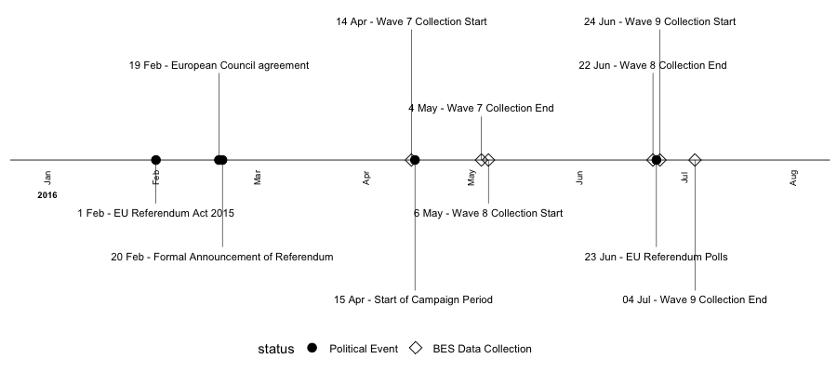
Data
YouGov-administered British Election Study (BES) 2014-2023 internet panel data. Waves 7 to 9.
Jarnach, C., 2023, WAPOR

Slide 9
Data II
to separate the time of cause and effect:
data from wave 9 => dependent variable
and data from waves 7 and 8 => explanatory variables
sample size = 20,918 participants
Use of cumulative panel weights for this sample to achieve results that are representative of the general population.
Jarnach, C., 2023, WAPOR

Slide 10
Method
Quasi-experimental pretest-posttest design with observational data and inferential statistical analysis using logistic regression models
Dependent variable: EU Referendum Vote Intention / Vote
Explanatory variables of interest: political news consumption sources and volume
Internet (not including online newspapers)
Television
Newspaper (including online)
Radio
talking to other people.
Jarnach, C., 2023, WAPOR

Slide 11
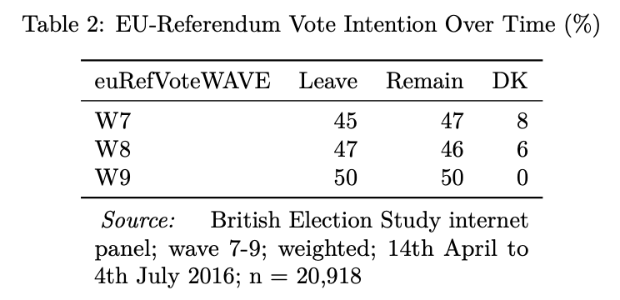
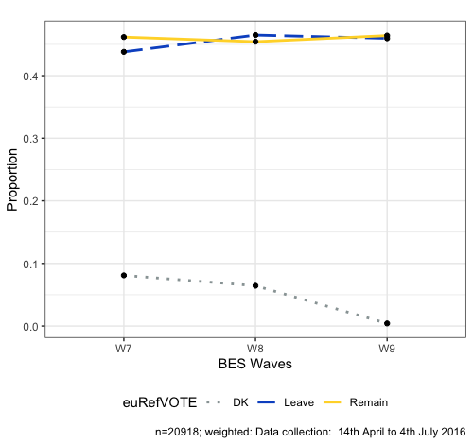
Results
Table 1: EU-Referendum Vote Intention (%)
Figure 1: EU-Referendum Vote Intention
Jarnach, C., 2023, WAPOR
Notes:
78% of the sample did not change their vote, meaning that only 22% of voters changed their answer to the question of how they would vote in a EU Referendum from the pre-campaign wave 7 to the post-treatment election recall wave 9.
| euRefVote change w7->w9 | % |
| ----------------------- | ---- |
| No change | 78% |
| Changed | 22% |
| Remain -> Leave | 4% |
| Leave -> Remain | 3.8% |
| DK -> Remain | 3.3% |
| DK -> Leave | 3.4% |
| L/R -> DK | 0.2% |

Slide 12
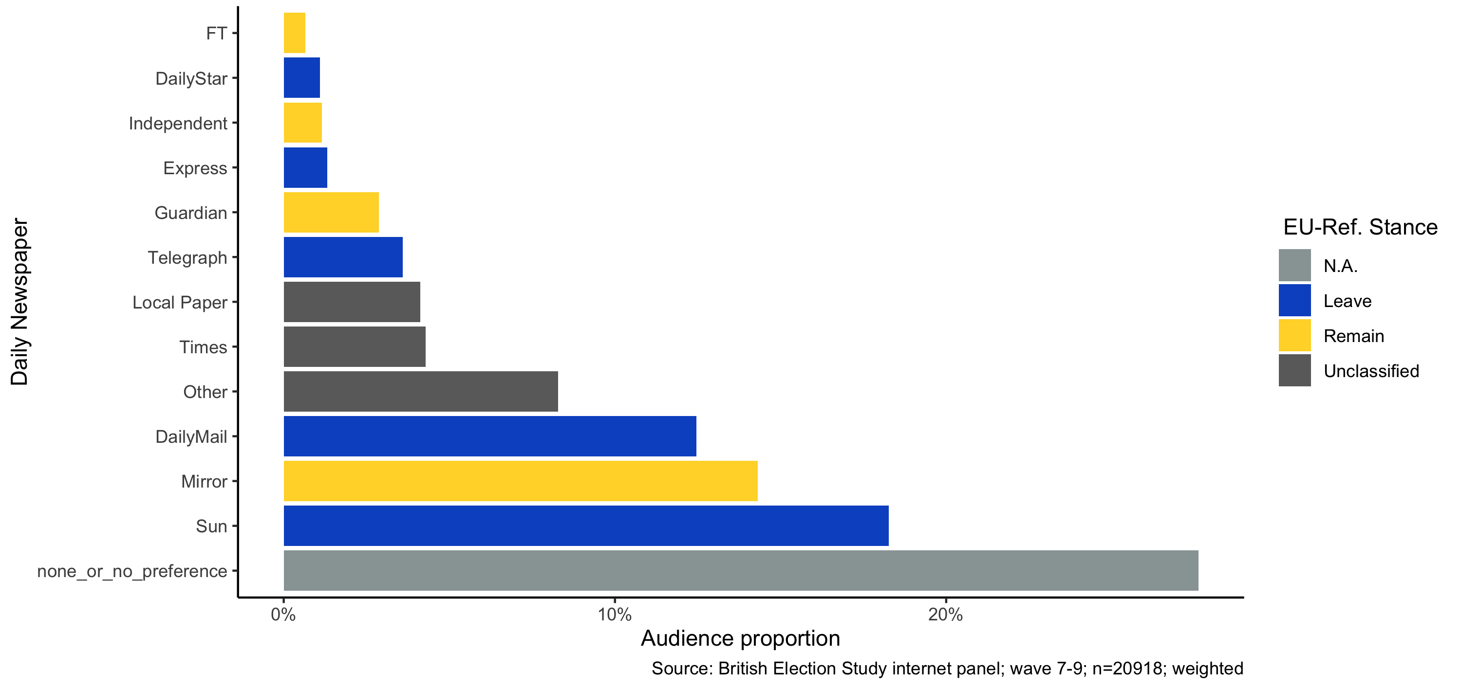
Figure 2: Popularity and EU-Referendum Stance of Daily Newspapers in the UK (April 2016; W7)
Jarnach, C., 2023, WAPOR

Slide 13
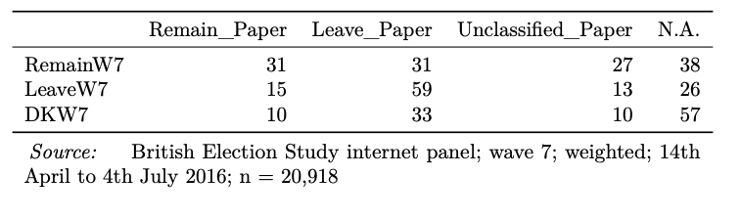
Table 2: Contingency table showing pre-campaign referendum voting intentions (w7) and EU-Referendum stance of preferred daily newspaper (w7); given in row-%
Jarnach, C., 2023, WAPOR

Slide 14
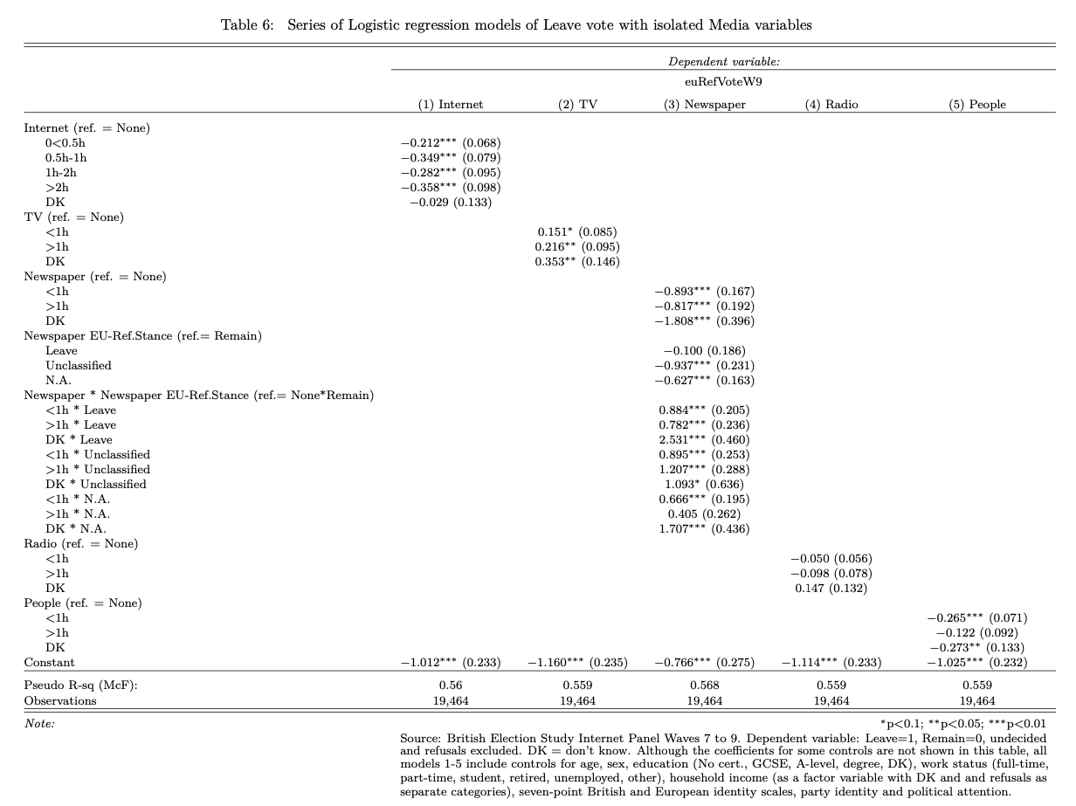
Table 3: Logistic regression models of Leave vote with isolated Media variables
Jarnach, C., 2023, WAPOR

Slide 15
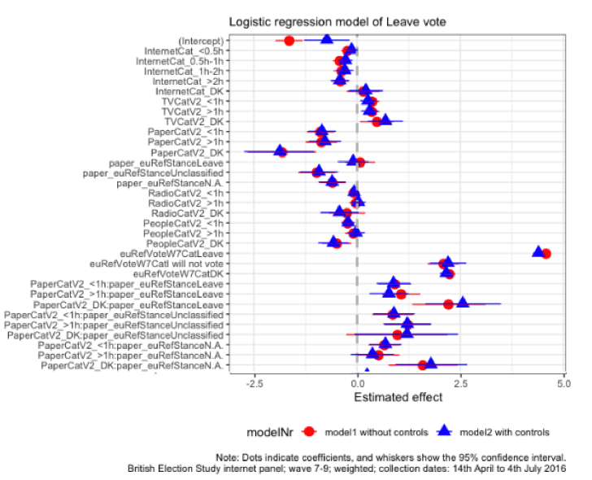
Figure 3: Coefficients of Logistic Regression Model 1 & 2
Jarnach, C., 2023, WAPOR

Slide 16
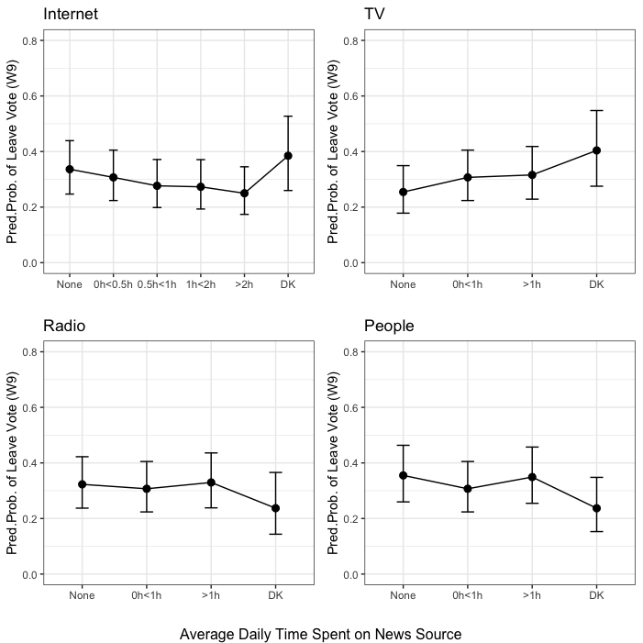
Figure 4: Predicted Probabilities for a Leave Vote in the EU-Referendum by Level of News Consumption and Media Type
Jarnach, C., 2023, WAPOR

Slide 17
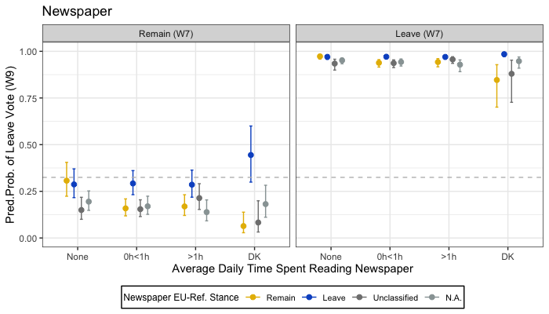
Figure 5: Predicted Probabilities of Voting Leave in the EU-Referendum based on Newspaper Consumption and Newspaper Brexit Stance, split by Pre-Treatment Voting Intention.
Jarnach, C., 2023, WAPOR

Slide 18
Conclusion
Results of the study show a clear link between news consumption and the EU Referendum vote.
News consumption during the lead-up to the referendum (consumption levels and choice of media) significantly influenced individuals' vote choices.
The impact of media consumption on opinions depends on the specific medium used for obtaining political news.
Generally, the influence of media on voting behaviour slightly increases with more time spent using a particular news medium.
Jarnach, C., 2023, WAPOR

Slide 19
Conclusion II
Online political content consumption (excluding newspapers) decreased the likelihood of choosing a Leave vote, with the probability declining as Internet usage increased.
Watching television news inclined individuals towards voting for Leave.
Radio news consumption had no significant impact on voting intentions.
Engaging in discussions with others discouraged voting for Leave if they lasted less than an hour daily.
Newspaper readership, including online newspapers, showed signs of selective exposure, with most readers favouring publications aligned with their political beliefs.
Even-handed news coverage did not guarantee even influence on voters.
Television news, primarily led by supposedly neutral news providers like the BBC, may have unintentionally favoured the Leave campaign by providing impartial coverage.
Jarnach, C., 2023, WAPOR

Slide 20
Next Steps
Investigate mechanism behind TV consumption favouring Leave vote
Closer look at media consumption interactions and media networks
Investigate more cases of ‘even-handed’ public broadcasters influencing public opinion in a real-world context, such as the EU Referendum and future democratic events.
Further research on potential impact of ‘impartiality fraud’, where news is presented under the assumption of being neutral and impartial yet systematically favours one political side over the other.
Jarnach, C., 2023, WAPOR
Notes:
As in yesterdays workshop by Ingo Scholtes: Higher-Order Network Analytics for Time-Stamped Data on Social Interactions

Slide 21

Thank You!
clemens.jarnach@gtc.ox.ac.uk
https://linktr.ee/clemensjarnach
Jarnach, C., 2023, WAPOR

Slide 22
References I
Dahl, R. A. (1989). Democracy and its critics [electronic resource]. In Democracy and its
critics. Yale University Press.
Festinger, Leon. 1962. A Theory of Cognitive Dissonance. Stanford (Calif.): Stanford university press.
Habermas, Jürgen. 1989. The Structural Transformation of the Public Sphere : An Inquiry into a Category of Bourgeois Society. Cambridge: Polity.
Klapper, Joseph T. 1960. The Effects of Mass Communication. Glencoe, Ill.: Free Press.
Kunda, Ziva. 1990. ‘The Case for Motivated Reasoning’. Psychological bulletin 108(3): 480–98.
Lazarsfeld, P.F., and R.K. Merton. 1948. ‘Mass Communication, Popular Taste, and Organized Social Action’. In The Communication of Ideas, ed. L. Bryson. New York: Harper.
Newman, N et al. 2022. ‘Reuters Institute Digital News Report 2022’. Reuters Institute for the Study of Journalism.
Jarnach, C., 2023, WAPOR

